Slide 1
Autism 204: Naturalistic Developmental Behavioral Interventions for Autism Spectrum Disorder
Mendy Minjarez, PhD
Seattle Children’s Autism Center
University of Washington, Department of Psychiatry and Behavioral Sciences
April 16, 2020

Slide 2
Disclosures
Hoffman La-Roche
Brookes Publishing
  Changes in schedule, specific phobias, reactivity to sensory input, externalizing behaviors

Slide 3
Presentation Overview
ASD intervention
ABA in treatment of ASD
Naturalistic Developmental Behavioral Interventions (NDBI) overview
Implementation of NDBI
Embedded teaching examples
Resources

Slide 4
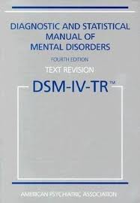

Diagnosis: DSM-IV to DSM-5
Social Interaction
Social Communication
Restricted/ Repetitive Interests and Behaviors
Communication
Restricted/ Repetitive Interests and Behaviors
Notes:
As you may know, currently work groups are underway to reevaluate…
…what’s being proposed that the distinctions between Autistic disorder will be taken away and instead the proposal is to have them all called ASD, with modifiers according to severity.
Severity metric based on level of support needed
Social Communication Disorder

Slide 5

2018 Prevalence Rates in the USA
1 in 59 children (1.7%) in the USA have ASD
Affects 4 males to 1 female
  1/39 boys
  1/152 girls
Intellectual abilities:
  31% intellectual disability (IQ < 70)
  25% in the borderline range (IQ = 71 - 85)
  44% in the average to above average range (IQ > 85)
Notes:
What do we know about autism?
CDC, 2016 report:
Across the 11 ADDM Network sites, estimated ASD prevalence among children aged 8 years was 23.6 per 1,000 (one in 42) boys and 5.3 per 1,000 (one in 189) girls; site-specific ASD estimates for boys ranged from 13.9 per 1,000 (in Maryland [health records only reviewed]) to 39.1 per 1,000 (in New Jersey), and for girls from 2.2 per 1,000 (in Maryland) to 9.3 per 1,000 (in New Jersey)
The overall prevalence estimate for 2012 was nearly identical to the reported estimate for the ADDM Network in 2010 of 14.7 per 1,000, or one in 68 children aged 8 years. However, because of differences between 2010 and 2012 in the geographic area covered and record source types reviewed for some individual ADDM Network sites, comparing the overall prevalence estimates might be misleading. For this reason, comparisons of ASD prevalence estimates between 2010 and 2012 were restricted to the eight sites for which the geographic surveillance area and record source type reviewed were comparable between the two surveillance years, including five sites with sufficient information on intellectual ability among children with ASD for both years. When results were restricted to these eight sites, combined ASD prevalence estimates were similar for 2010 and 2012, including in subgroups defined by sex and race/ethnicity

Slide 6

ASD Intervention

Slide 7
Areas to Target in Intervention
Communication skills
Engagement & motivation
Attention and imitation
Social skills
Play/leisure
Cognitive/academic skills
Behavioral challenges
Motor skills
Self-help/life skills (adaptive functioning)

Slide 8
Intervention Intensity and Timing
“Intensity is best thought of in the context of large numbers of functional, developmentally relevant, and high interest opportunities to respond actively”
(National Research Council, 2001)
“Earlier is better”

Slide 9
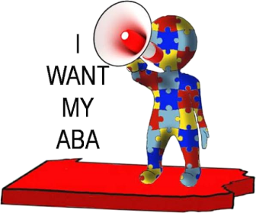
Applied Behavior Analysis (ABA)
Gold standard treatment for core ASD deficits
Now covered by Medicaid and many other insurance plans (but not all)
  To access under Medicaid, need COE evaluation
  Orders/statement of medical necessity for ABA
Different “types” of ABA
  Discrete trial teaching
  Naturalistic Developmental Behavioral Interventions
    Pivotal Response Teaching
    Incidental Teaching
    Early Start Denver Model
    Project ImPACT

Slide 10

ABA in Treatment of ASD

Slide 11
What is ABA?
Science of behavior change (learning)
Principles that govern learning identified, described, and studied
Used intentionally to increase skills or decrease unwanted behaviors
Used in treatment of many disorders, including ASD
Use of scientific methods to reliably demonstrate that behavioral improvements are caused by the prescribed interventions

Slide 12
ABC Sequence in ABA
Antecedent
Behavior
Consequence
A
B
C
Antecedent:
Happens Before
Behavior
Behavior: Child
Response
Consequence:
Outcome of
Behavior

Slide 13
Increasing Appropriate Behaviors
Teaching a New Behavior
Cues are purposely used to increase a behavior that is not already happening
    Antecedent: Creating an instruction/opportunity, situation, or indication that a behavior should take place
      What is the child’s cue to engage in the behavior?
    Behavior: Teaching the correct/necessary skill
      What response should take place, given the antecedent?
    Consequence: Contingent reinforcement
      Anything that is provided or taken away that strengthens or maintains the desired behavior
A
B
C

Slide 14
Example: Teaching a New Behavior
    Antecedent: Parent and child are in front of a closed door and parent prompts child to say “open”
    Behavior: Child says “open”
    Consequence: Parent opens the door
    This positive consequence increases the likelihood that this child will say “open” the next time they are at the door. Learning has occurred!
A
B
C

Slide 15
ABA Interventions for Autism
Discrete Trial Naturalistic Behavioral
Controlled and paced by the instructor. | Learner-initiated, usually by requests or gestures for preferred items.
Often occurs in sit-down sessions; setting arranged to minimize distractions. | Occurs in the context of other activities; setting includes items of interest among naturally occurring stimuli.
Teaching stimuli typically teacher-selected items. | Stimuli used are learner-selected items.
Reinforcers typically unrelated to teaching stimuli. | Contingent access to learner-selected items used as reinforcement.

Slide 16
Comparing Teaching Examples
Discrete Trial Naturalistic Behavioral
Teaching Names:
Using flashcards with photos of familiar people—reinforce correct name with edible | Play with familiar people—reinforce correct name with tickles, etc. from that person
Teaching Colors:
Using shapes that are different colors—reinforce correct color with access to preferred toy | Using puzzle with different color pieces—reinforce correct color by placing piece in puzzle
Teaching Imitation:
Prompt imitation of actions (e.g., clap hands)—reinforce correct response with edible | Prompt imitation of actions using preferred toy (e.g., drive car)—reinforce correct response with toy

Slide 17

Naturalistic Developmental Behavioral Interventions Overview

Slide 18

American Academy of Pediatrics (2015)
for Children < age 3
Begin as early as possible
Active family/caregiver involvement
Combination of developmental and behavioral approaches
Address specific social communication delays & associated developmental issues
Consider medical disorders that may affect behavior and response to intervention
Notes:
Similar findings in more recent papers when looking at the increasing evidence for children who begni intervention before age 3
For MH, we began early and based on our EBP review, are likely to recommend behavioral strategies combined iwht developmental and his doctor has considered other medical issues as well, including things like how his overeating may be a concern.

Slide 19
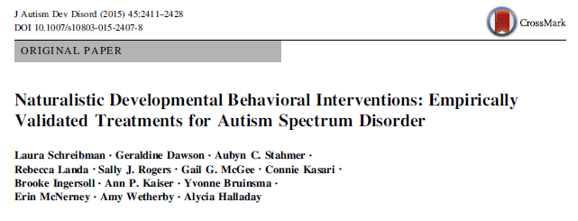
Naturalistic Developmental Behavioral Interventions (NDBI; Schreibman et al., 2015)

Slide 20
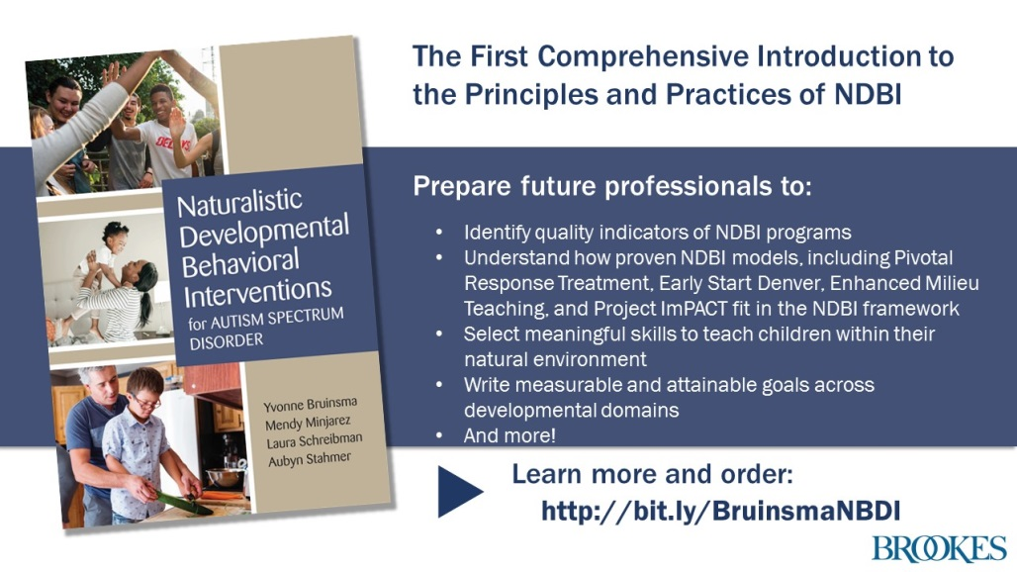
NDBI for ASD Book (Bruinsma, Minjarez et al. 2019)
Comprehensive documentation of NBDI strategies
Dissemination tool
Enhance, rather than replace NDBI models

Slide 21
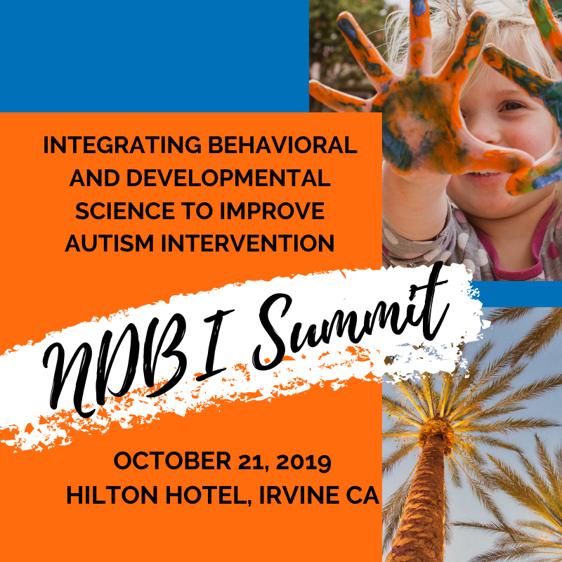

Slide 22

NDBI Common Elements: Core Components
Behavioral
Naturalistic Developmental Behavioral Interventions
Developmental
Notes:
For younger children especially, for a variety of reasons there has been a Move toward more “naturalistic” interventions.
Less highly structured
Conducted in context of natural interactions and environments increase generalization and amainteance.
Incorporation of developmental science into the design and implementation of interventions and content of curricula
“Naturalistic Developmental Behavioral Interventions”
(NDBIs).

Slide 23
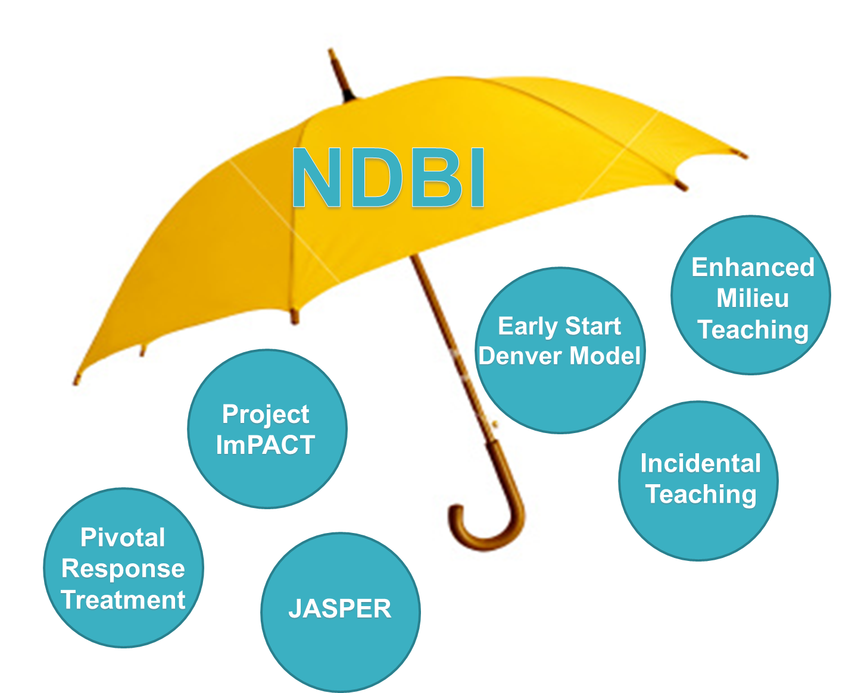
Notes:
So we want to consider the full range of evidence-based interventions available to us as behavioral practitioners and choose based on the needs of the child, family, behavior we are addressing etc.
ABA does not equal DTT

Slide 24
Naturalistic Developmental Behavioral Interventions (NDBI; Schreibman et al., 2015)
All have strong empirical support
Pivotal Response Treatment*
(PRT; Schreibman & Koegels )
Project ImPact*
(Ingersoll & Dvortcsak)
Incidental Teaching
(McGee)
Joint Attention Symbolic Play Emotion Regulation* (JASPER; Kasari)
Early Start Denver Model*
(ESDM; Rogers & Dawson)
Enhanced Milieu Teaching
(Hancock & Kaiser)
*One or more RTC’s to support effectiveness

Slide 25

NDBI Common Elements
Learning targets
  All developmental domains
  Program for generalization from beginning
  Skills are not taught in isolation
Learning context: embedded trials
  Emotionally-meaningful interactions
  Natural context
  Routines
Development-Enhancing Strategies
  Behavioral: e.g., prompting, reinforcement
  Developmental: e.g., imitation of the child, use of affect, modeling

Slide 26

NDBI Common Elements: Procedural
Manualized
Treatment fidelity
Ongoing measurement / Data driven decision making
Notes:
Video link: https://youtu.be/z2DcaPF0hzY

Slide 27
NDBI Common Elements: Instructional Strategies
Use of 3-part contingency
Environmental arrangements
Shared control and natural reinforcement
Broadening of attentional focus (multiple cues)
Prompting and prompt fading
Child initiated teaching episodes
Balanced turns within teaching routines (reciprocity)
Adult imitation of child language, play or body movements
Modeling

Slide 28

Implementation of NDBI

Slide 29

Role of Motivation in Teaching Children
with ASD
Focus on motivation is critical because:
  Motivation is a core deficit in ASD
  Cannot rely on social motivation that
  typically developing children have
Balance of motivation with targeting skills
  These are of equal importance
  Motivation → Engagement → Context for teaching
  Targeting skills → Progress

Slide 30
How Can I Tell if the Child is Motivated?
Motivational Variable | Operational Definition
Responsivity | How often is the child answering me?
Reciprocity | How often does the child respond to adult social bids in a synchronous way?
Response latency | How quickly is the child answering me?
Child affect | Affect: How happy is the child? Do I see smiling, happy facial expressions, laughing and energy? Engagement: Do I see that the child is interested, even enthusiastic in the activity, and remaining in proximity? Behavior: How much challenging behavior does the child display?
Social orienting | Is the child looking at me? Is their body turned toward me?
Joint attention | Is the child alternating eye gaze to share enjoyment? Is s/he pointing, showing or giving?
Imitation | Is the child imitating actions or sounds/words?
Initiation | Is the child initiating communication, play, and interaction with me or does s/he only respond when I initiate?

Slide 31
NDBI Programs
Skills still broken down and taught systematically
Teaching embedded in natural activities
Reinforcement is directly related to the task (natural)
Incorporates developmental perspective: Intervention is…
  Play based
  Within daily routines in natural environment
  Child driven

Slide 32
Embedding Teaching Trials
Role of adults in the natural environment
Incorporate behavioral teaching principles across settings
  Daily routines
  Natural adult-child interactions
  Play interactions
Embed teaching trials (A-B-C) during natural adult-child interactions

Slide 33
Creating Opportunities for Learning
Opportunity: Any question/offer/instruction or circumstance that the adult creates or provides to the child where the child is expected to respond with a specific behavior being targeted
Goal: To provide as many behaviorally-based learning opportunities as possible during the child’s natural interactions, activities, and routines
These strategies can be used to teach any behavior/goal
Developmental strategies simultaneously embedded

Slide 34
Shared Control in Learning Opportunities
Shared Control
Antecedent
Behavior
Consequence
A
B
C
Opportunity
Presented
Child Responds
Response
Reinforced

Slide 35

Shared Control Strategies
Use child-selected, highly preferred activities
Follow the child’s lead
Provide choices
Share control of materials
Take balanced turns (reciprocity)

Slide 36

Developmental Strategies: Fostering Engagement, Affect, and Shared Enjoyment
Effective use of affect
  Tone, pitch, and voice prosody
  Body language and gestures
  Facial expressions
  Matching affect to the child’s current state
Effective use of animation (e.g., voice, facial expressions, gestures)
Consistent response to the child’s communication and emotional cues

Slide 37

Developmental Strategies: Imitating the Child
Imitate the child’s:
  Actions on objects
  Gestures and body movements
  Vocalizations/verbalizations
Mirroring child actions + narration
Imitate with novel actions

Slide 38
Video Examples: NBDI
Incidental Teaching:
https://www.youtube.com/watch?v=yzgC9ZPzot8
Pivotal Response Teaching:
https://www.youtube.com/watch?v=KERrGaKcd38
Early Start Denver Model (ESDM):
https://vimeo.com/7983899

Slide 39

Embedded Trails: Teaching Examples

Slide 40
Controlled Access/Shared Control
Adult control over objects; The adult holds the object out of reach until the child communicates; Can be thought of as the general definition of shared control
Nonverbal | Early Language | Complex Language
Holding up a stuffed animal and waiting Providing the toy when the child points to it | Holding up a piece that goes with the puzzle the child is doing Providing the piece when the child labels it (e.g., “cow”) | Holding up two sets of toys for the child to choose from Providing a set when the child uses a phrase to request (e.g., “Let’s play barn yard”)

Slide 41
In Sight, Out of Reach: Environment
Storing items where they can be seen, but not accessed (e.g., storing preferred toys up high or in clear bins that cannot be opened without help)
Nonverbal | Early Language | Complex Language
Storing snacks on high shelf Providing to child contingent on pointing to request | Storing phone or tablet on counter Providing access contingent on single word request (e.g., “phone”) | Storing remote control on mantle Providing access contingent on phrase to request (e.g., “Please turn on Daniel Tiger”)

Slide 42
In Sight, Out of Reach: Activity
Setting up an activity so that materials can be seen, but not accessed (e.g., setting up art supplies on the table, but out of the child’s reach)
Nonverbal | Early Language | Complex Language
Placing crayons out of reach on the table while coloring Exchanging a picture card to request a crayon | Placing tools out of reach while playing play-doh Single word (e.g., “roller”) to request new tool | Placing stickers out of reach during art Phrase (e.g., “Three green stickers”) to request stickers

Slide 43
Reducing Adult Anticipation of Child Needs/Wants
Although the child’s wants/needs may be known, wait for the child to communicate before automatically providing what they want/need
Nonverbal | Early Language | Complex Language
Waiting at the door, rather than opening it for the child to go outside Opening the door when the child points to it | Waiting with the child’s coat in hand instead of automatically putting it on Putting the coat on when the child says, “coat” | Waiting when the child is struggling with building a block tower, rather than helping Helping after the child says, “I need help building the tower”

Slide 44
Inadequate Portions/Breaking It Up
Providing a few pieces of a set at a time in order to elicit multiple communication trials; Applies best to toys or snacks with multiple pieces or sets of items
Nonverbal | Early Language | Complex Language
Providing a few goldfish crackers in a bowl Providing more when the child reaches for the bag on the table | Providing the child with Mr. Potato Head, but keeping the pieces Providing each piece as the child labels it (e.g., “nose”, “eyes”) | Providing child several blocks, while keeping the rest Providing more pieces as the child says what he is building next (e.g., “I am going to build the roof now”)

Slide 45
Intentional Ignoring
Ignoring child on purpose, especially when s/he needs help or the adult has a preferred object, to create opportunities for appropriately gaining attention
Nonverbal | Early Language | Complex Language
Turning away from the child when his cup is empty Turning back to accept the empty cup for help when the child taps the adult’s shoulder | Turning away while holding the needed puzzle piece Turning back to provide the piece when the child says “mom” | Turning away while holding the paint brush for the paints the child already has Turning back, when the child calls the adult by name

Slide 46
Sabotage
Providing parts of an activity, while withholding obvious necessary parts
Nonverbal | Early Language | Complex Language
Providing cereal without a spoon Giving the spoon when the child points to it | Providing tracks without any trains Giving the trains when the child says, “train” | Providing the pieces to the game, but not the board Giving the board when the child says, “We need the board to play the game”

Slide 47


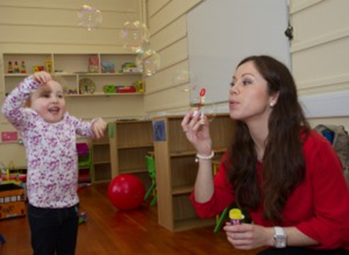
Summary
NDBI:
  The “least restrictive” form of intervention
  Developmentally appropriate for young children
  Can use more structured teaching (e.g., DTT) when needed
  Promotes generalization and maintenance
NDBI can be delivered in the natural environment, while still maintaining treatment fidelity and data collection.
Get creative! Embedding teaching trials is fun, silly, and motivating for kids!
NDBI can be used to teach any skill.

Slide 48
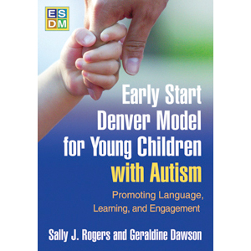
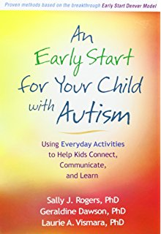
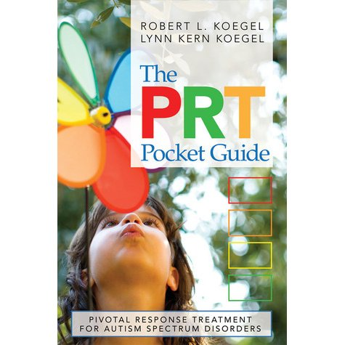
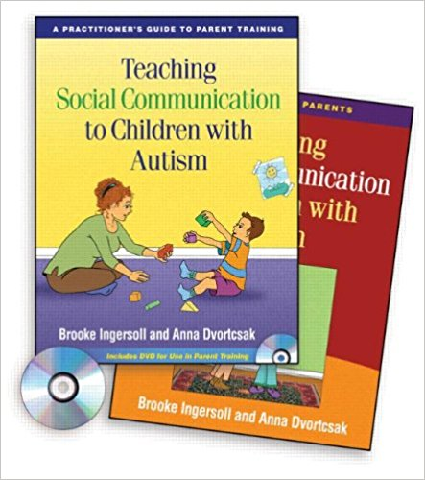
Resources
Naturalistic Developmental Behavioral Interventions: Available Manuals
Early Start Denver Model
  ESDM
  Rogers & Dawson/Rogers, Dawson & Vismara
Pivotal Response Treatment
  PRT
  Koegel & Koegel
Improving Parents as Communication Partners
  Project ImPact
  Ingersoll & Dvortcsak

Slide 49
Today Into Tomorrow
Research
  Active treatment components
  Precision medicine
  Meaningful outcome measurement
Training
  Procedural fidelity
  Incorporate into academic programs
  Training for certified professionals
Community Implementation
  Increased access to care
  Novel service delivery models
  Availability of materials (e.g., manuals, curricula, parent training)

Slide 50
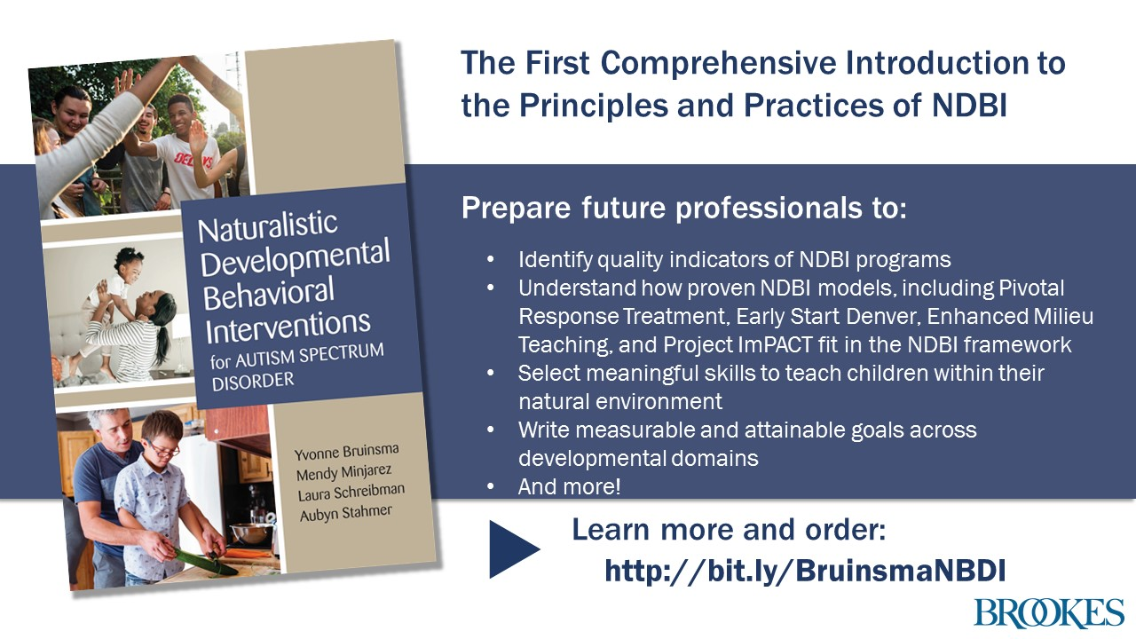
“Exceptionally well organized and presented, [this book] is an ideal curriculum textbook and unreservedly recommended to the attention of professionals working with autistic children and adults.” –Helen Dumont, Reviewer

Slide 51


Resources
Intervention: Reviews of Empirical Support
National Autism Center at May Institute
  National Standards Project
    https://www.nationalautismcenter.org/national-standards-project/
National Professional Development Center on Autism Spectrum Disorders
  The National Clearinghouse on Autism Evidence and Practice
    https://autismpdc.fpg.unc.edu/national-professional-development-center-autism-spectrum-disorder

